Slide 1

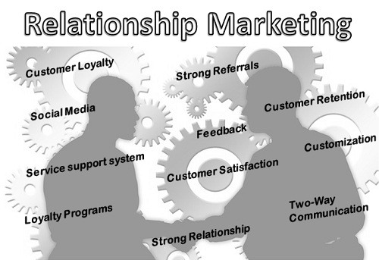
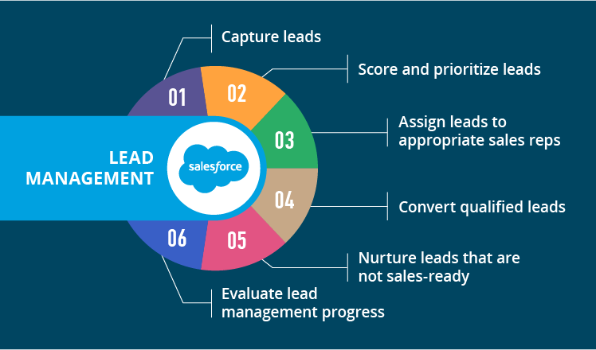
Marketing Models
CHAPTER 13
Business Intelligence: Carlo Vercellis

Slide 2
Relational Marketing
Initiate, strengthen, intensify and preserve over time the relationship between the company and the stakeholder
Insurance companies – for selecting marketing segment for a new type of policy
Mobile Phone provider – identify customers with highest probability of churning
Bank- for issuing credit cards for a group of customers. (identify the group)

Slide 3
Relational Marketing - Objectives
Increase growth of customers – complexity
Increased marketing activities – customization
E-Commerce – global comparison
Customer loyalty – uncertain
Progressive commoditization of products - differentiation is mainly due to levels of service
Large amounts of sales data that can be transformed into knowledge
The number of competitors using advanced techniques for the analysis of marketing data has increased.

Slide 4
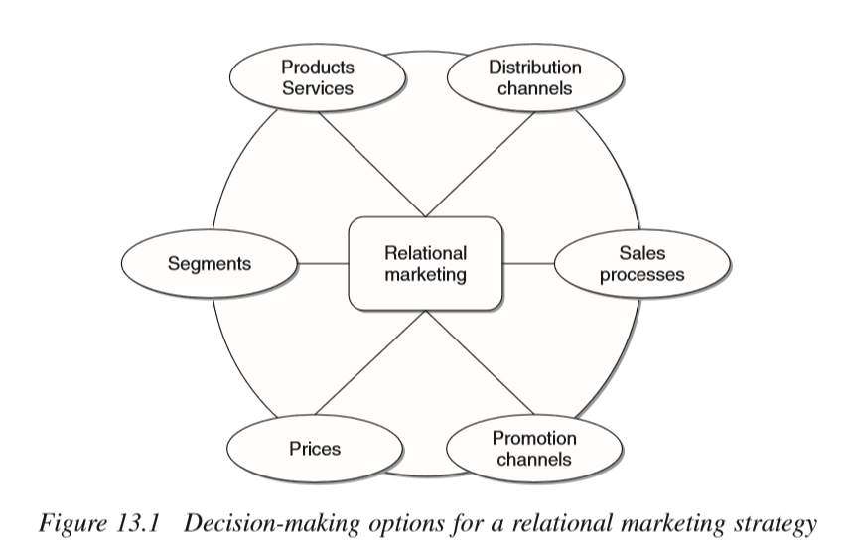

Slide 5
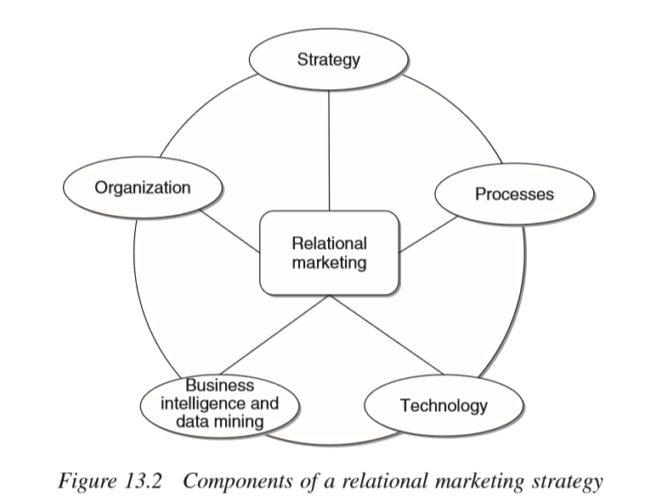

Slide 6
Relational Marketing
The ability to effectively exploit the information gathered on customers’ behavior represents today a powerful competitive weapon for an enterprise.
A company capable of gathering, storing, analyzing and understanding the huge amount of data on its customers can base its marketing actions on the knowledge extracted and achieve sustainable competitive advantages.
Enterprises may proﬁtably adopt relational marketing strategies to transform occasional contacts with their customers into highly customized long-term relationships.
In this way, it is possible to achieve increased customer satisfaction and at the same time increased proﬁts for the company, attaining a win–win relationship.

Slide 7
Relational Marketing v/s CRM
Relationship marketing - a sales and marketing concept, CRM - tools used to carry out the concept.
Relationship marketing - implemented as a strategy and includes activities such as identifying long-term sales and retention goals, public relations, marketing and advertising campaigns.
CRM - operational tasks that support the relationship marketing strategy. Acitivities may include gathering data about the customers, then organizing and analyzing it to create target customer profiles.
RM to CRM - Relationship marketing - increase sales by building trust and engaging customers; CRM system - allows a salesperson to quickly and consistently deliver what customers are looking for with each and every interaction, because their preferences and buying history are recorded.
CRM to RM - The system benefits the customers, because they see the business "knows" them. CRM systems coordinate, automate and deliver online and offline advertising and marketing activities that help build the long-term customer relationships that are crucial to a successful relationship marketing strategy.

Slide 8
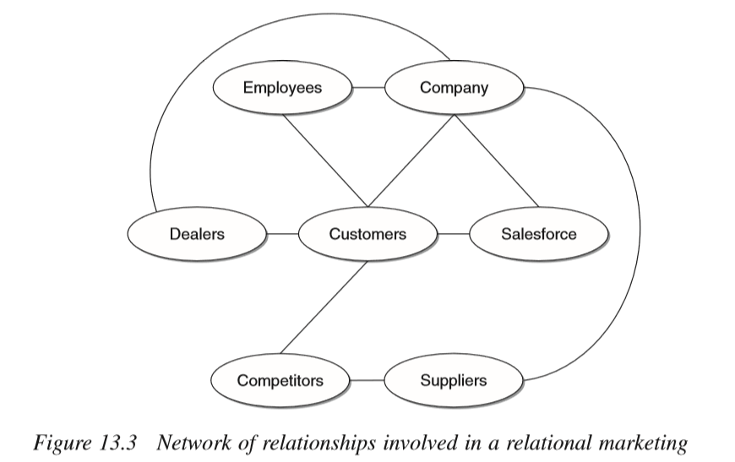

Slide 9
Examples - Network of relationships
The manufacturers of consumer goods, available at the points of sale of large and small retailers, do not have direct information on the consumers purchasing their products.
The manufacturers of goods covered by guarantees, such as electrical appliances or motor vehicles, have access to personal information on purchasers, even if they rarely also have access to information on the contacts of and promotional actions carried out by the network of dealers.
A savings management company usually places shares in its investment funds through a network of intermediaries, such as banks or agents, and often knows only the personal data of the subscribers.
A pharmaceutical enterprise producing prescription drugs usually ignores the identity of the patients that use its drugs and medicinal products, even though promotional activities to inﬂuence consumers are carried out in some countries where the law permits.

Slide 10
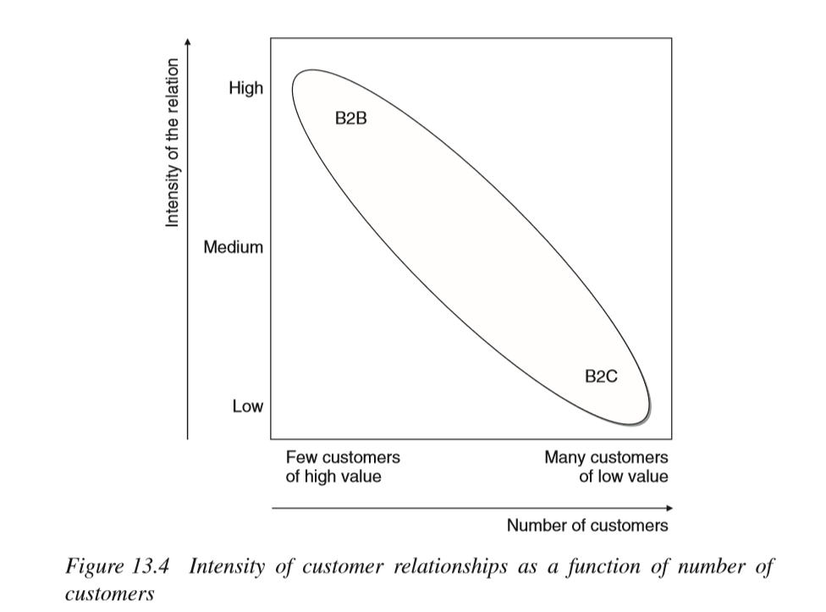
B2B – Few customers of high value – in contact personally
B2C – Many customers of low value – impersonal contact – websites, point of sale.

Slide 11
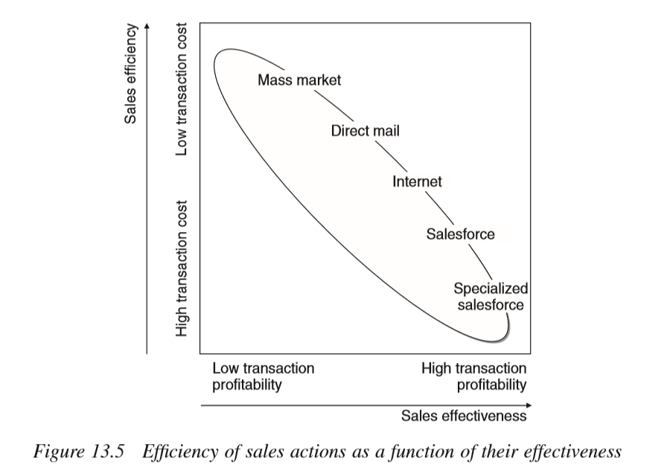

Slide 12
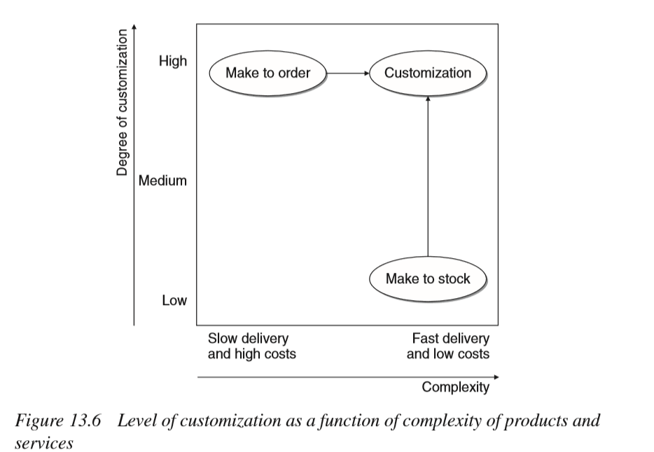

Slide 13
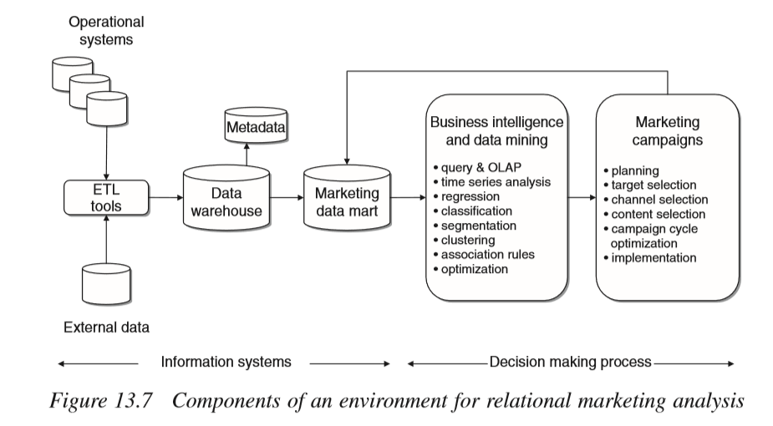

Slide 14
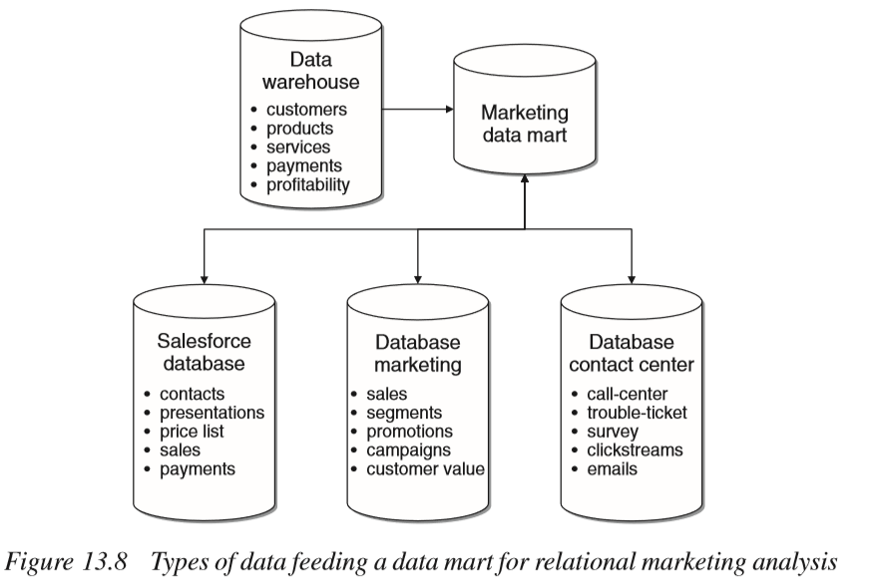

Slide 15
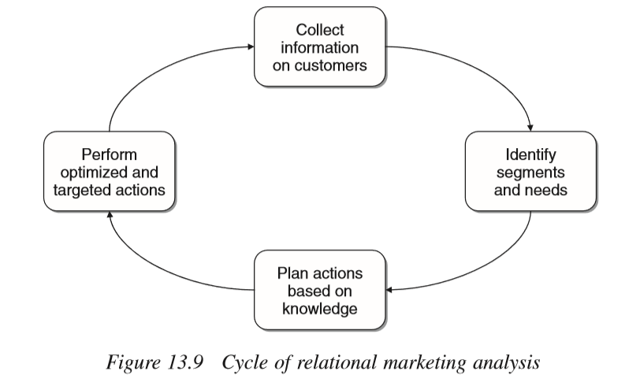

Slide 16
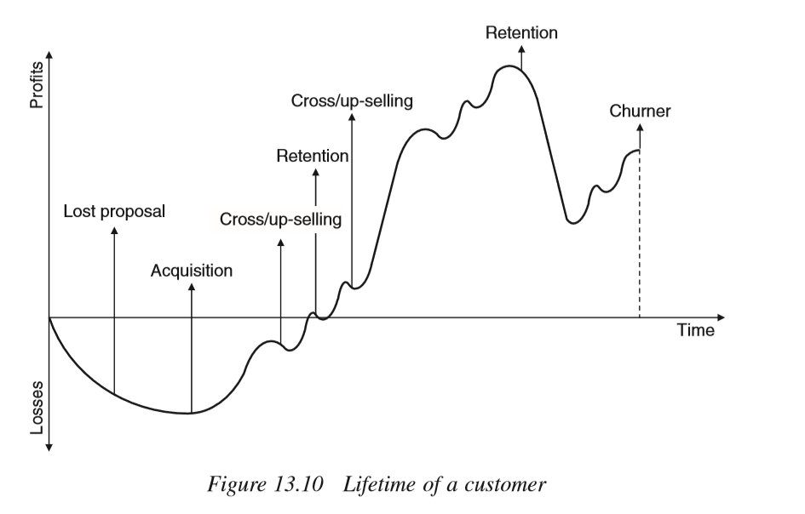

Slide 17
Life time of a customer
Acquisition - identiﬁcation of new prospects
Retention - maturity stage ; retain customers.
  It has been empirically observed that the cost of acquiring a new customer, or winning back a lost customer, is usually much higher – of the order of 5 to 9 times higher – than the cost of the marketing actions aimed at retaining customers considered at risk of churning.
Cross-selling
Up-selling

Slide 18
Market basket analysis
The purpose is to gain insight from the purchases made by customers in order to extract useful knowledge to plan marketing actions.
Mostly used to analyze purchases in the retail industry and in e-commerce activities.
Data – purchase transactions data associated with the time dimension.
Each transaction consists of a list of purchased items- called a basket.
Transactions to be connected - If transactions cannot be connected to one another; apply association rules

Slide 19
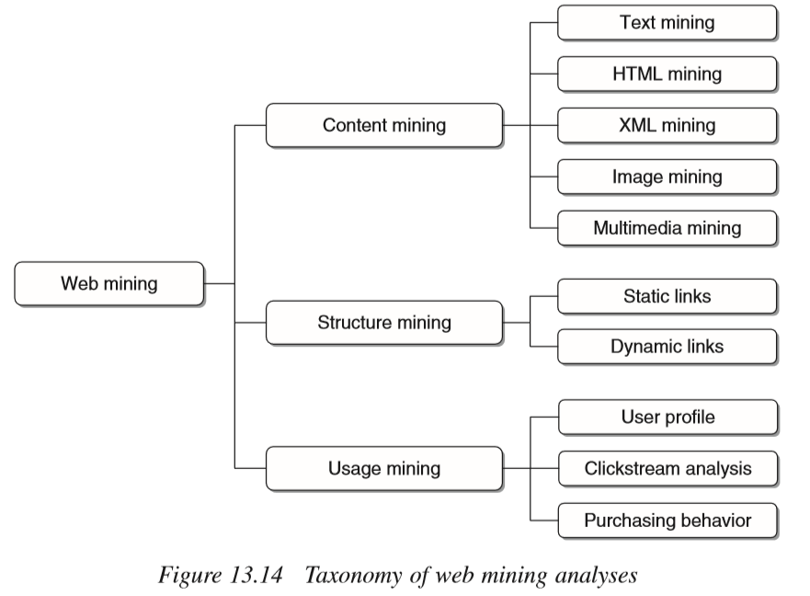
Web mining

Slide 20
SalesForce Management
Salesforce - whole set of people and roles that are involved, with different tasks and responsibilities, in the sales process.
Salesforce Automation - use of software tools
Residential Sales :- Takes place at one or more sites managed by a company supplying some products or services, where customers go to make their purchases. This category includes sales at retail outlets as well as wholesale trading centers and cash-and-carry shops.
Mobile Sales :- agents of the supplying company go to the customers’ homes or ofﬁces to promote their products and services and collect orders.
Telephone sales :- are carried out through a series of contacts by telephone with prospective customers.

Slide 21
SalesForce Management (Mobile Sales)
designing the sales network;
planning the agents’ activities;
contact management;
sales opportunity management;
customer management;
activity management;
order management;
area and territory management;
support for the conﬁguration of products and services;
knowledge management with regard to products and services

Slide 22
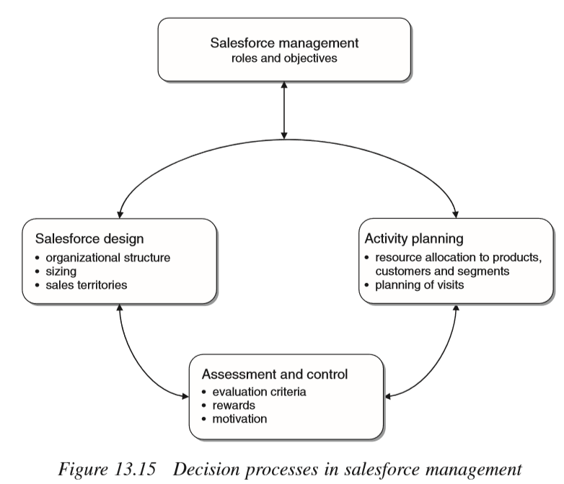
Decision processes

Slide 23
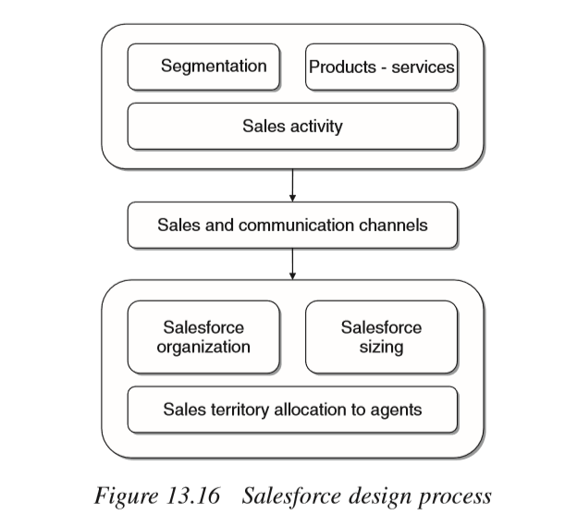
Sales Design

Slide 24
Business case studies
Retention in telecommunications
SCENARIO :-
Mobile telephone industry were the ﬁrst to use learning models and data mining methods to support relational marketing strategies.
One of the main objectives has been customer retention, also known as churn analysis.
The effect of market saturation and strong competition have combined to cause instability and disaffection among consumers, who can choose a company based on the rates, services and access methods that they deem most convenient.
This phenomenon is particularly critical with regard to prepaid telephone cards, very popular in the mobile phone industry today, as they make changing a telephone service provider quite easy and of little cost.

Slide 25
Retention in telecommunications
Company and objectives
A mobile phone company wishes to model its customers’ propensity to churn
A predictive model able to associate each customer with a numerical value (or score) that indicates their probability of discontinuing service, based on the value of the available explanatory variables.
The model should be able to identify, based on customer characteristics, homogeneous segments relative to the probability of churning,
In order to later concentrate on these groups the marketing actions to be carried out for retention, thus reducing attrition and increasing the overall effectiveness.

Slide 26
Retention in telecommunications
Data for constructing predictive model
customer type (business or private);
telephone card type (subscription or prepaid);
years of service provision, whether above or below a given threshold;
area of residence.
personal information (socio-demographic);
administrative and accounting information;
incoming and outgoing telephone trafﬁc, subdivided by period (weeks or months) and trafﬁc direction;
access to additional services, such as fax, voice mail, and special service numbers;
calls to customer assistance centers;
notiﬁcations of malfunctioning and disservice;
emails and requests through web pages.

Slide 27
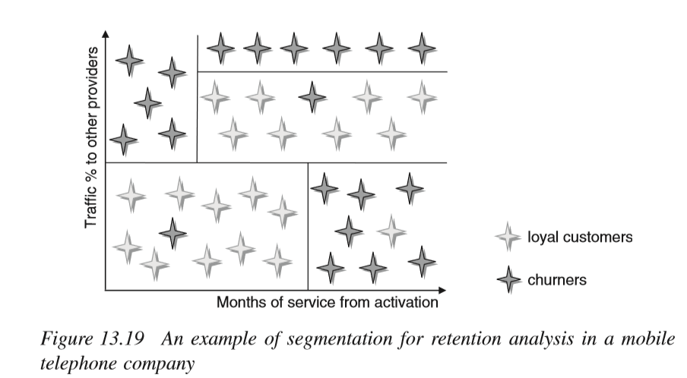

Slide 28
Retention in telecommunications
Analysis and results
Once the dataset for developing the models has been extracted from the data mart, a detailed exploratory analysis can be carried out.
On the one hand, it shows a certain number of anomalies, in the form of outliers and missing values, whose removal improves the quality of data.
On the other hand, additional variables can be generated through appropriate transformations in order to highlight relevant trends and correlations identiﬁed by exploratory data analysis.
After applying feature reduction and extraction, the new dataset contains about 150 predictive variables, after the addition of derived variables and removal of some original variables deemed uninﬂuential on the target.
An indicator variable is deﬁned to denote churning by a customer in cases where ofﬁcial notiﬁcation of service discontinuation is not required, as is the case for prepaid cards. For example, if a private customer makes fewer outgoing calls than a preset threshold and receives a number of incoming calls that is below a second threshold value, she is believed to be at a churning stage.

Slide 29
Business case studies
Acquisition in the automotive industry
A company manufacturing industrial vehicles wishes to develop a predictive model that can assign to each prospect a score that indicates his propensity to positively respond to a marketing action aimed at acquisition.
The main purpose of the model is to provide guidance for promotion actions carried out by the network of dealers.
Reﬁne the knowledge of the customer base and of the market scenarios, and identifying the distinctive features that characterize current customers in order to design initiatives directed to stimulate new acquisitions.

Slide 30
Acquisition in the automotive industry
Analysis and results
Prospects and customers. The ﬁrst group of data concerns current or potential customers of the company, including customers owning vehicles not necessarily produced by the company. Besides demographic information, the data include 15 explanatory variables that gather meaningful information, such as the top-rated type of vehicle owned by each prospect, the number of new and used vehicles produced by competitors and owned by each prospect, and the number of new and used vehicles bought in the past by each prospect.
Vehicles. The second group of data includes 16 attributes that enable the vehicles owned by each prospect to be identiﬁed, among them model, weight class, optional features, fuel type, ﬁrst and last registration date and status (new or used vehicle). These attributes deﬁne for each vehicle the timing of sales transactions, or transfers of ownership.
Works. The third group of data refers to maintenance and repair work undergone by the vehicles during the warranty period and beyond. In particular, these data indicate the type of work carried out, a description of the problem, the vehicle mileage at the time of service, the car shop where the repair was carried out and the date of admission and release of the vehicle to and from the shop.

Slide 31
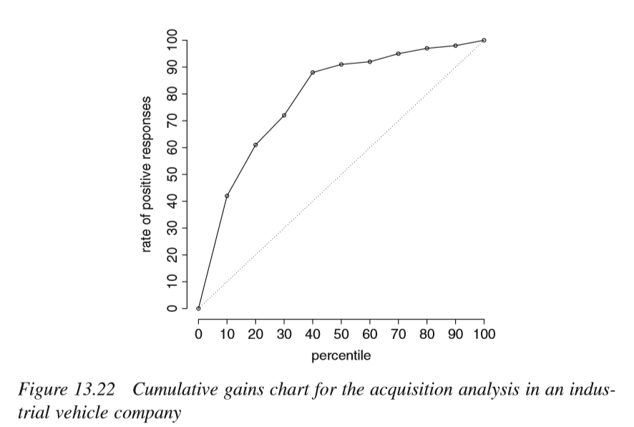
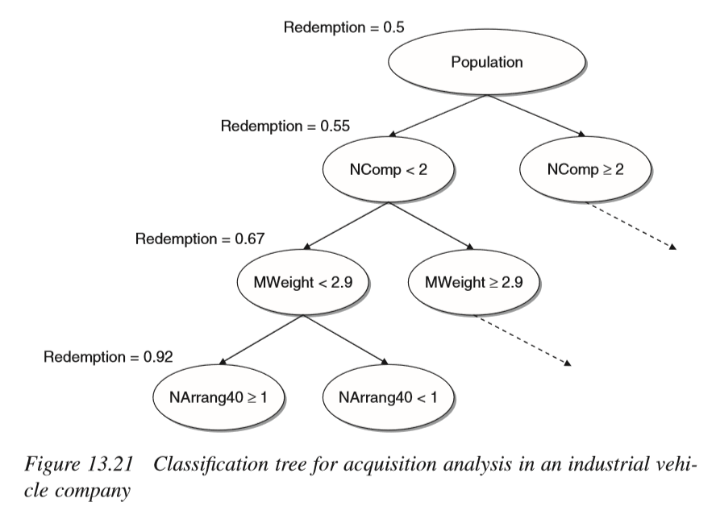

Slide 32
Business case studies
Cross-selling in the retail industry
Segment its customer base in order to optimize marketing actions aimed at promoting a speciﬁc product or group of products.
The goal is therefore to develop a predictive model able to assign to each customer a score that indicates her propensity to respond positively to a cross-selling offer.
Besides prediction purposes, the model should be used also to interpret explanatory factors that have a greater effect on the purchase of the product promoted. Finally, the model is to be used for assessing the existence of causal and temporal correlations between the purchase of the product promoted and the purchase of other items.

Slide 33
Cross-selling in the retail industry
Analysis and results
personal information (socio-demographic);
date of signing up for the loyalty card, which can be regarded as the starting date for the relationship between customer and company;
dates of ﬁrst and last purchase, marking the boundary of the time interval within which purchases have been made by each individual customer;
cash slips, indicating which items, and in what quantities, have been purchased by each customer;
purchases of sale items made by each customer;
participation in point-earning programs and related prizes won;

Slide 34
